Slide 1
Input and Output
4.3

Slide 2
Reading Input
When a program asks for user input
It should first print a message that tells the user which input is expected
System.out.print("Please enter the number of bottles: "); // Display prompt
This message is called a prompt
Use the print method, not println, to display the prompt Leave a space after the colon
System.in has minimal set of features
Must be combined with other classes to be useful
Use a class called Scanner to read keyboard input.

Slide 3
Reading Input - Scanner
To obtain a Scanner object:
Scanner in = new Scanner(System.in);
Use the Scanner's nextInt method to read an integer value:
System.out.print("Please enter the number of bottles: "); int bottles = in.nextInt();
When the nextInt method is called,
The program waits until the user types a number and presses the Enter key; After the user supplies the input, the number is placed into the bottles variable; The program continues.
Use the nextDouble method to read a floating-point number:
System.out.print("Enter price: "); double price = in.nextDouble();
To use the Scanner class, import it by placing the following at the top of your program file:
import java.util.Scanner;

Slide 4
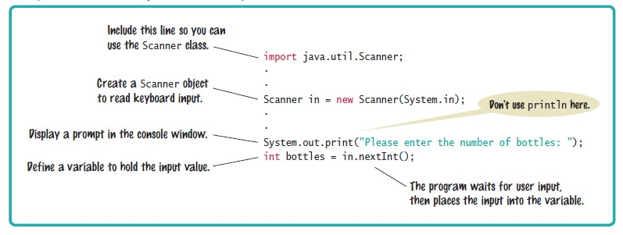
Syntax 4.3 Input Statement

Slide 5
Formatted Output
Use the printf method to specify how values should be formatted.
Printf lets you print this
Price per liter: 1.22
Instead of this
Price per liter: 1.215962441314554
This command displays the price with two digits after the decimal point:
System.out.printf("%.2f", price);

Slide 6

Formatted Output
You can also specify a field width:
System.out.printf("%10.2f", price);
This prints 10 characters
Six spaces followed by the four characters 1.22
This command
System.out.printf("Price per liter:%10.2f", price);
Prints
Price per liter: 1.22

Slide 7
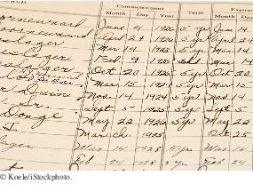
Formatted Output
You use the printf method to line up your output in neat columns.

Slide 8
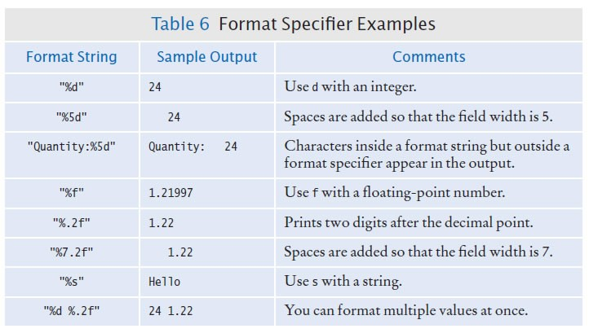

Slide 9
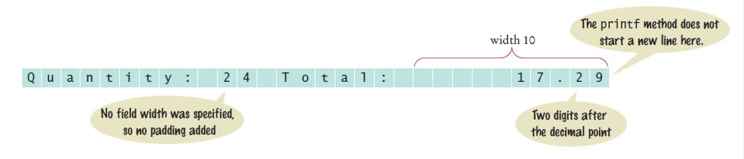
Formatted Output
You can print multiple values with a single call to the printf method. Example
System.out.printf("Quantity: %d Total: %10.2f", quantity, total);
Output explained:

Slide 10
Homework
Pg 148 #11 – 16
Write a short program (Main method only) which will input the length of the side lengths of a rectangle, and will print the area, perimeter, and diagonal length each on their own line. Make sure that each value is rounded to 2 decimal places if necessary, and that all values are aligned vertically. Use the Pythagorean theorem for the diagonals.

